Slide 1


Smoking-Related Behavior Analysis in United States
Team Members:
Marvin Mananghaya (msm796)
Rufei Sheng (rs6431)
Tanya Nabila (tn1050)
Urwa Muaz (um357)
Xiao Jing (xj655)
Dec. 17, 2018

Slide 2

Overview
Introduction
Data Gathering
Exploratory Analysis
Hypothesis Testing
Residual Analysis
Predictive Analysis
Limitations & Future Works
Notes:
Robin
– Description of challenge and constraints
– Project objectives and performance metrics
– What you know and what you don’t

Slide 3
Introduction
Project Theme: Smoking Behavior Analysis in United States
Project Objective:
Identify socioeconomic, health and lifestyle condition that influence smoking.
Determine if and to what extent can these features predict smoking behavior at individual level
*
‹#›
Notes:
Robin
– Description of challenge and constraints
– Project objectives and performance metrics
– What you know and what you don’t

Slide 4
Data Gathering
Data Sources
Main source (individual level):
Behavioral Risk Factor Surveillance System (BRFSS 2017) from CDC
Secondary source (state level):
Cigarette Retail Tax
US State Shapefile
Tobacco Retail Price
Prevalence of key search terms on Google Trending
*
‹#›
Notes:
Tanya
The database is a system of ongoing health-related telephone surveys designed to collect data on health-related risk behaviors, chronic health conditions, and use of preventive services from the non-institutionalized adult population (≥ 18 years) residing in the United States.
Cigarette Retail Tax - The amount of cigarette tax in each state was gathered from the State Tobacco Activities Tracking and Evaluation (STATE) System records.
US State Shapefile - We performed spatial residual analysis of our linear model by visualizing it over the State boundaries shapefile.
Tobacco Retail Price - This data was captured from U.S. Food & Drug Administration
Prevalence of key search terms on Google : We used google trends to extract ‘Mormon’ key term and used it as proxy for state-wise prevalence on anti-smoking religious doctrine.
– Description of challenge and constraints
– Project objectives and performance metrics
– What you know and what you don’t

Slide 5
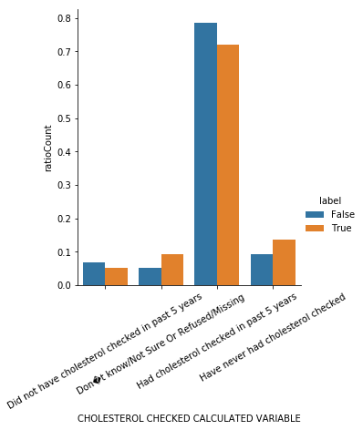
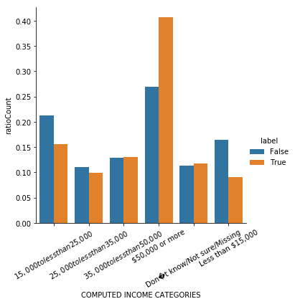
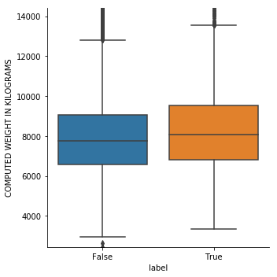
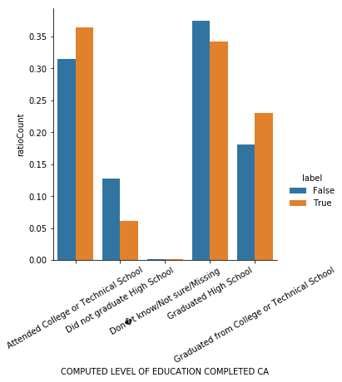
Exploratory Data Analysis
(0, 'COMPUTED PHYSICAL HEALTH STATUS'), (1, 'COMPUTED MENTAL HEALTH STATUS'), (2, 'HIGH BLOOD PRESSURE CALCULATED VARIABLE'), (3, 'CHOLESTEROL CHECKED CALCULATED VARIABLE'), (4, 'HIGH CHOLESTEROL CALCULATED VARIABLE'), (5, 'LIFETIME ASTHMA CALCULATED VARIABLE'), (6, 'CURRENT ASTHMA CALCULATED VARIABLE'), (7, 'COMPUTED ASTHMA STATUS'), (8, 'COMPUTED PREFERRED RACE'), (9, 'CALCULATED NON-HISPANIC RACE INCLUDING M'), (10, 'COMPUTED RACE-ETHNICITY GROUPING'), (11, 'COMPUTED NON-HISPANIC WHITES/ALL OTHERS'), (12, 'COMPUTED FIVE LEVEL RACE/ETHNICITY CATEG'), (13, 'COMPUTED RACE GROUPS USED FOR INTERNET P'),
…
…
... (18, 'COMPUTED BODY MASS INDEX CATEGORIES'), (19, 'OVERWEIGHT OR OBESE CALCULATED VARIABLE'), (20, 'COMPUTED NUMBER OF CHILDREN IN HOUSEHOLD'), (21, 'COMPUTED LEVEL OF EDUCATION COMPLETED CA'), (28, 'COMPUTED FRUIT INTAKE IN TIMES PER DAY'), (29, 'COMPUTED DARK GREEN VEGETABLE INTAKE IN'), (30, 'COMPUTED POTATO SERVINGS PER DAY'), (31, 'COMPUTED OTHER VEGETABLE INTAKE IN TIMES'), (32, '150 MINUTE PHYSICAL ACTIVITY CALCULATED'), (33, '300 MINUTE PHYSICAL ACTIVITY CALCULATED'), (34, 'FLU SHOT CALCULATED VARIABLE'), (35, 'PNEUMONIA VACCINATION CALCULATED VARIABL'), (36, 'EVER BEEN TESTED FOR HIV CALCULATED VARI'),
Notes:
Tanya

Slide 6
Feature Engineering & Class Imbalance
Feature Engineering
Transform the continuous number features into binary or ordinal features
Class Imbalance
Upsampling the minority
downsampling the majority
Finally we choose upsampling based on ROC Curve
Significant Features from Plotting | Feature Type
High cholesterol | Binary
Asthma | Binary
Computed Body Mass Index(Obese/Not Obese) | Ordinal
Level of education | Ordinal
No. of children(< 3/others) | Ordinal
Computed income(<50k/others) | Ordinal
Notes:
Tanya

Slide 7
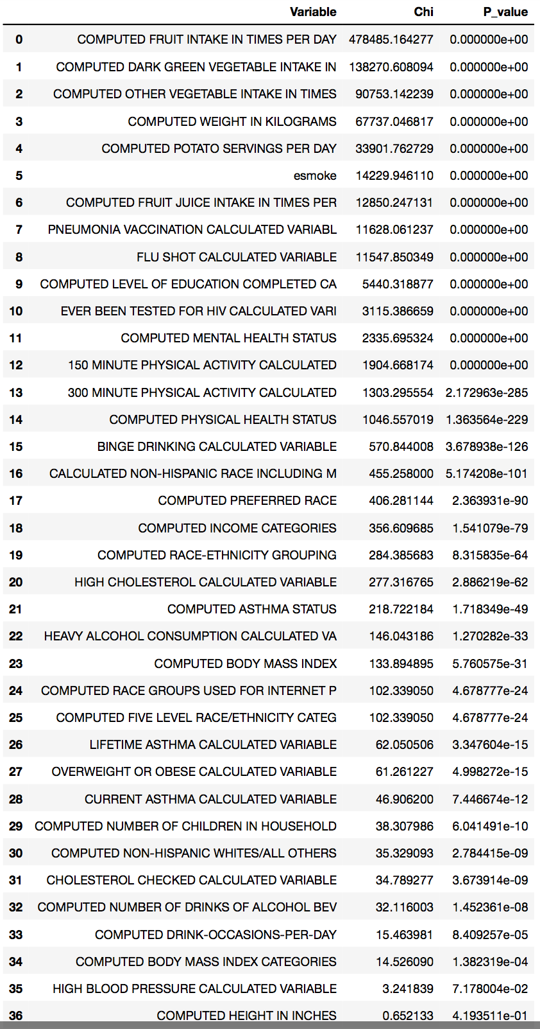
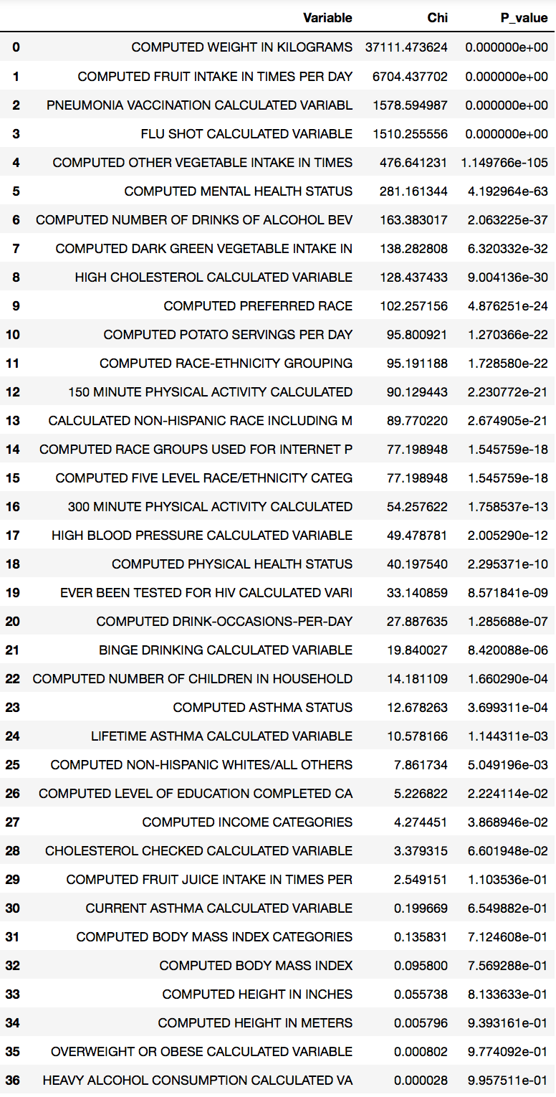
Hypothesis Introduction-Chi Square test
We used Chi-square hypothesis test to evaluate the significance of each features.
Top 5 features that shows most significant difference between two group.
Features passed [Smoker/Non-smoker]
Features passed [Smoker/E-smoker]
Notes:
Robin

Slide 8
Hypothesis Introduction-Chi Square test
Interesting findings: 6 more features have difference in smoker/non-smoker, but not in e-smoker/smoker test.
Features not passing [Smoker/Non-smoker]
Features not passing [Smoker/E-smoker]
‹#›
Notes:
Robin

Slide 9
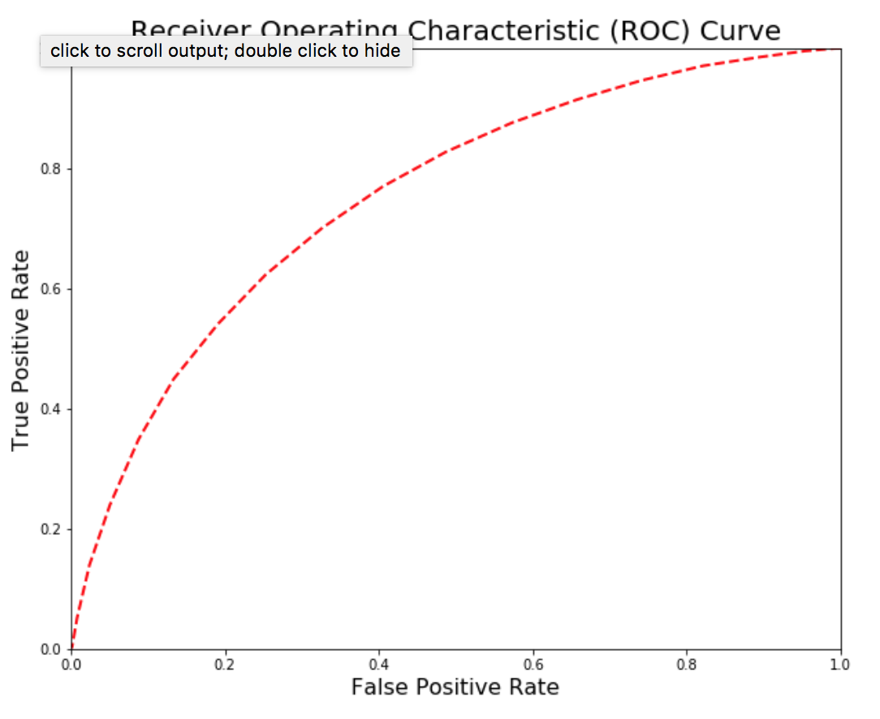
5. Methodologies
Process
Logistic Regression
Results
Smoker/non-smoker
Smoker/e-smoker
Predicted:
Smoker/Non-Smoker
Smoker/E-Smoker
Predictors:
Significant features identified from the chi-square test
- Estimate coefficients an
- Determine linear relationship
with predicted
- Feature importance
Best threshold | Highest Accuracy | AUC
0.5 | 0.688 | 0.752
Develop a ROC for various threshold values to find best possible model
Best threshold | Highest Accuracy | AUC
0.5 | 0.65 | 0.72
Notes:
Marvin

Slide 10
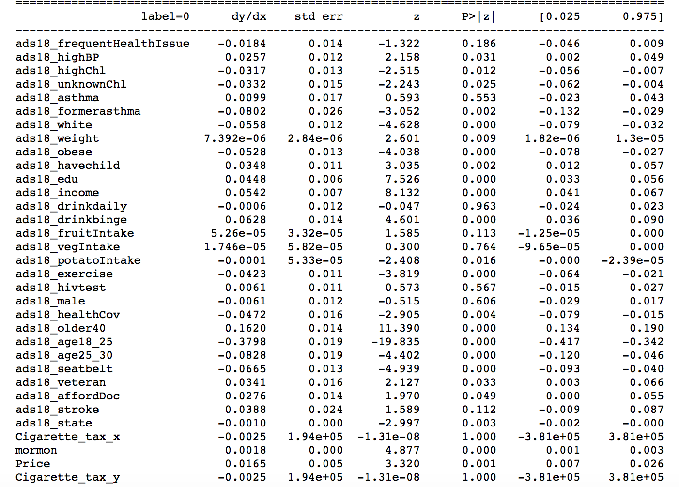
5. Methodologies
Logistic Regression : Marginal Results from
Smoker/Not Smoker

Slide 11
5. Methodologies
Logistic Regression : Marginal Results from
Smoker/E-smoker

Slide 12
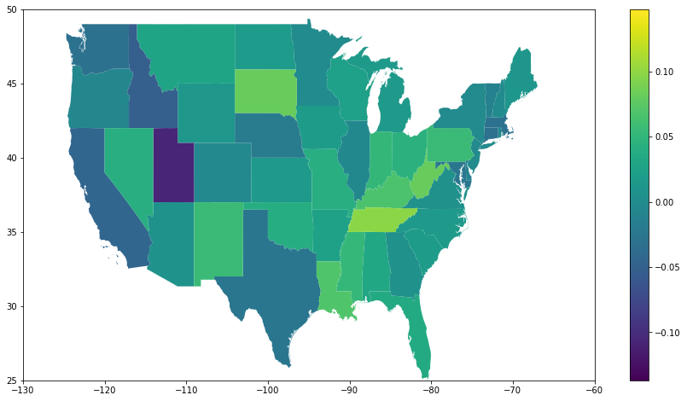
5. Methodologies
Residual Analysis
The average of the residuals at state level of the logistic model without the state level features
Map the residuals of the logistic regression at state level
Considers the Spatial Heterogeneity of features
Explore possible features to improve model performance
The group incorporates the features:
State tax on cigarettes
Retail price of cigarettes
Google trends keywords (more on that on the next slide)

Slide 13
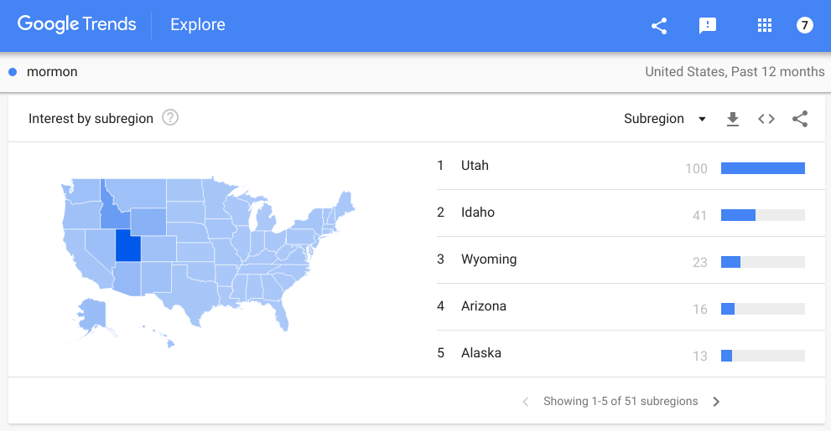
5. Methodologies
Residual Analysis
Initially the group plotted the residuals of the model on a state level base map.
Some states are particularly over/underestimated by the model
Utah
Idaho
We included google trends results for the keyword “mormon” as a proxy for the effect of religious customs, practices and traditions
Reduced model bias

Slide 14
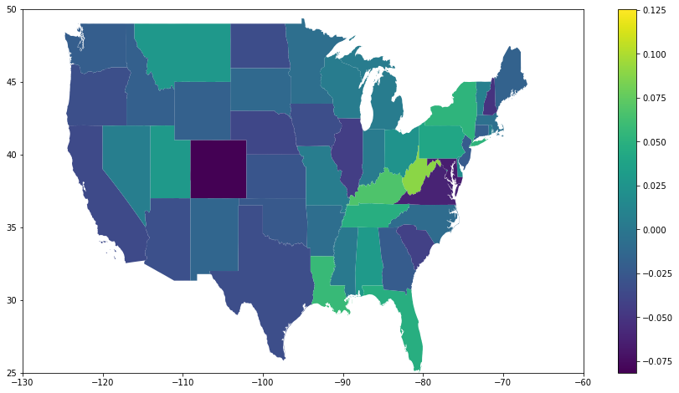
5. Methodologies
Residual Analysis
The average of the residuals at state level of the logistic model: After incorporating all state level features
Map the residuals of the logistic regression at state level
We have incorporated following variables in the model:
socioeconomic
health
lifestyle
state level features
The spatial heterogeneity that remains might be due to some other non modelled feature of it may represent local affinities for smoking when accounted for all other factors.

Slide 15
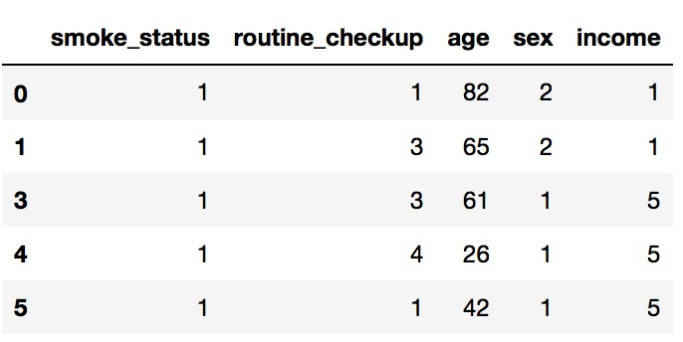
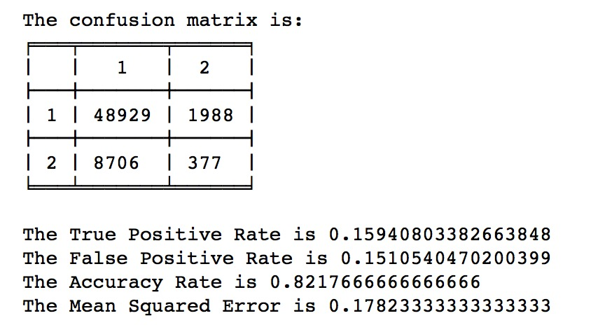
Counterfactual Causality Test

Slide 16
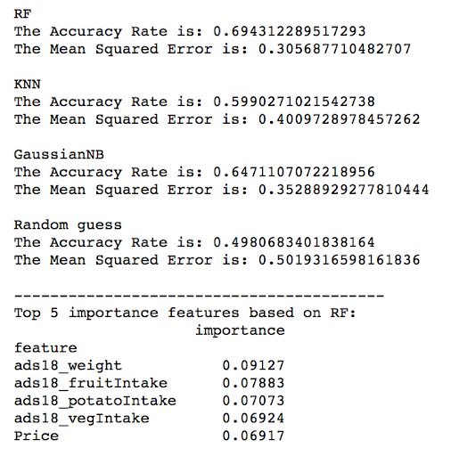
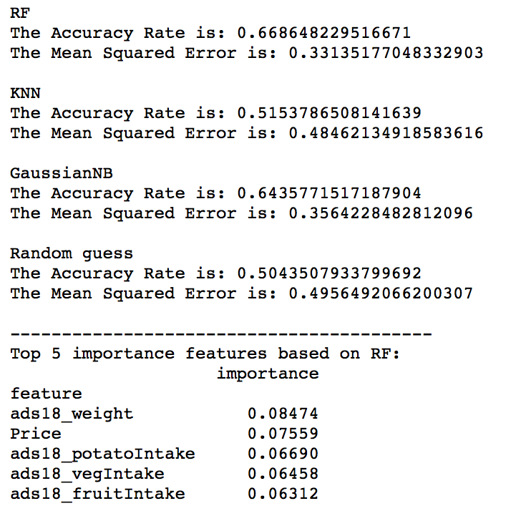
Predictive Analytics
Predicting non-smoker and smoker
Predicting e-smoker and smoker

Slide 17
Conclusion
Identifying socioeconomic, health and lifestyle condition that influence smoking
Increased cigarette tax rate in 2009 shows causal relationship with smoking behavior in some degree, but not significant.
Drinking habit is highly correlated with smoking habits.
People who are not aware of their cholesterol level are more likely to smoke. (not as concerned of their health?)
Habit of exercising and having a higher education makes you less likely to smoke.
Determine if and to what extent can these features predict smoking behavior at individual level
Socioeconomic, health and lifestyle conditions can determine the smoking habit of the individual with fair accuracy.
We get AUC greater than 0.7 which is very good when modelling human behavior.
We also see that there is a certain spatial trend

Slide 18
Thank You

Slide 19




1. Research Process
Research Process
Forming hypothesis
Data Acquisition, integration and Cleaning
Data Modelling and Analysis
Results and Conclusion
*
‹#›

Slide 20
2. Project Overview
Background:
Smoking is a major health hazard world wide and harms nearly every organ of the body.
According to CDC More than 16 million Americans are living with a disease caused by smoking.
Furthermore, smoking causes cancer, heart disease, stroke, lung diseases, diabetes, and chronic obstructive pulmonary disease (COPD), which includes emphysema and chronic bronchitis.

Slide 21
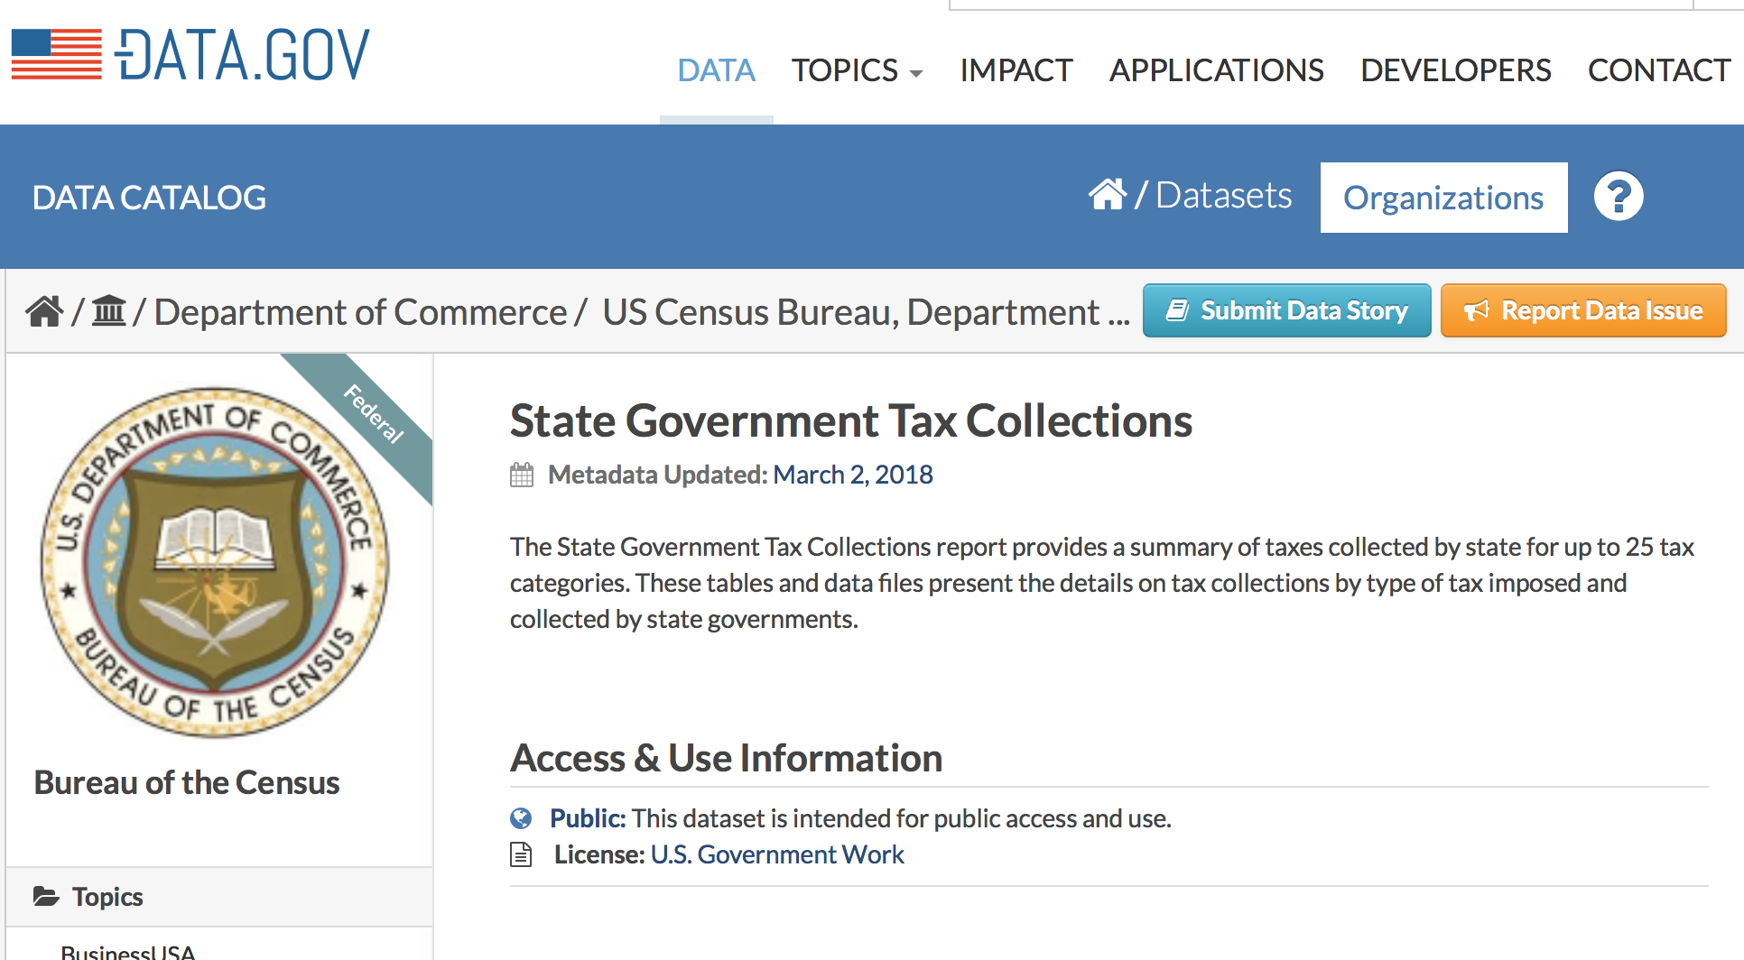
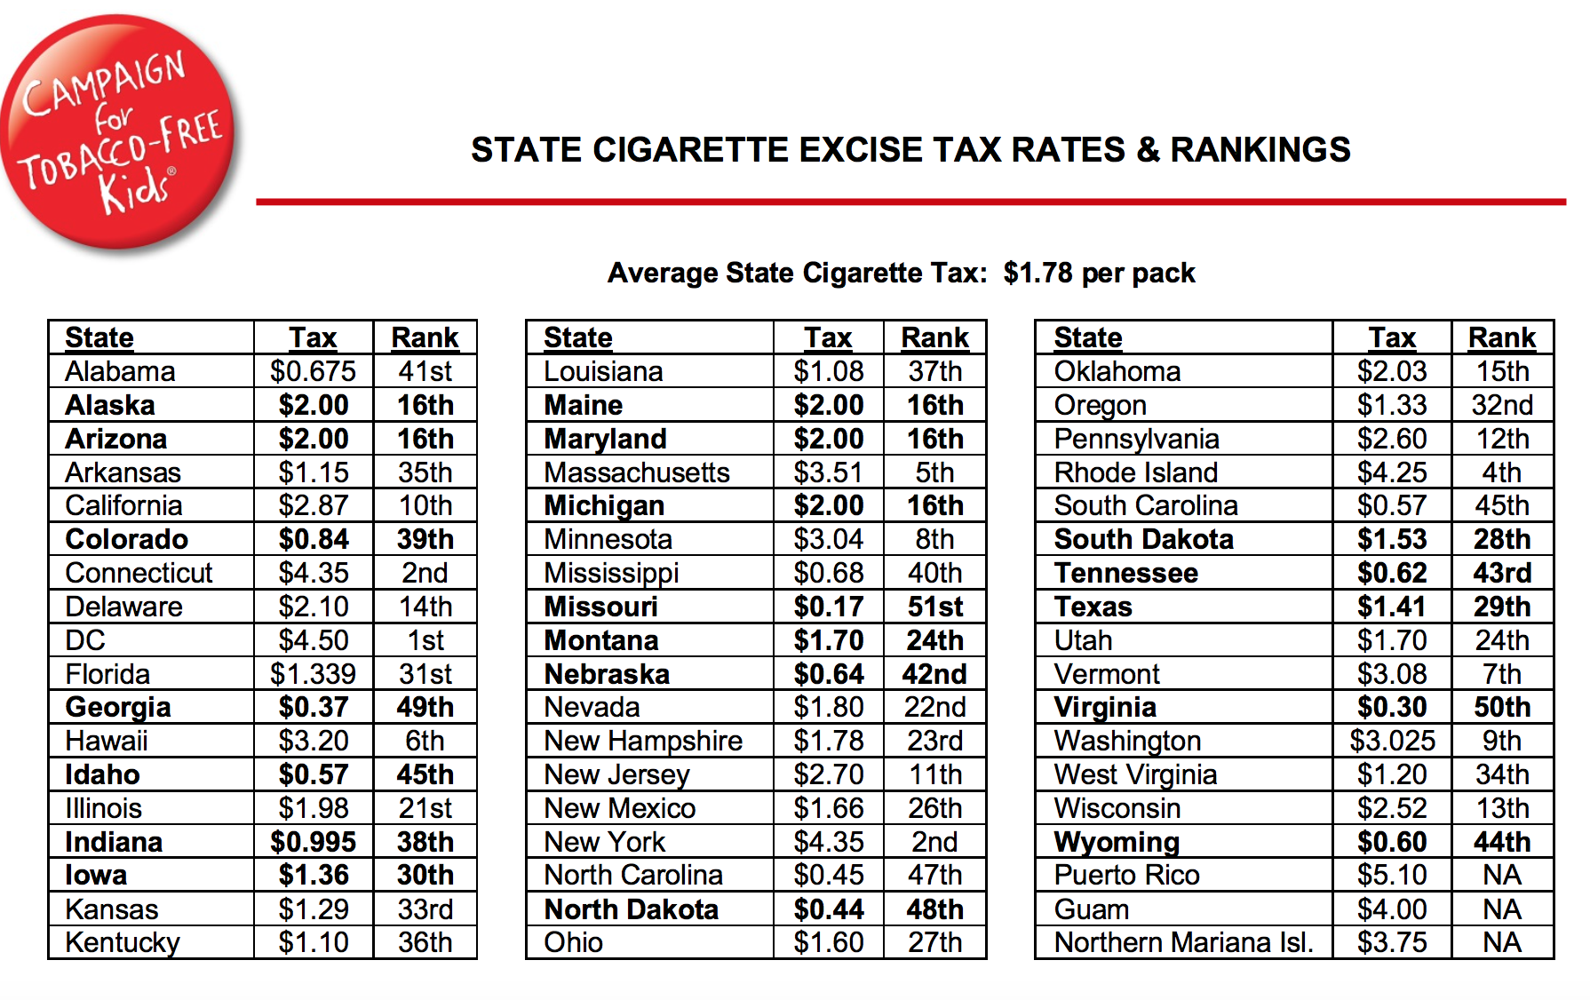
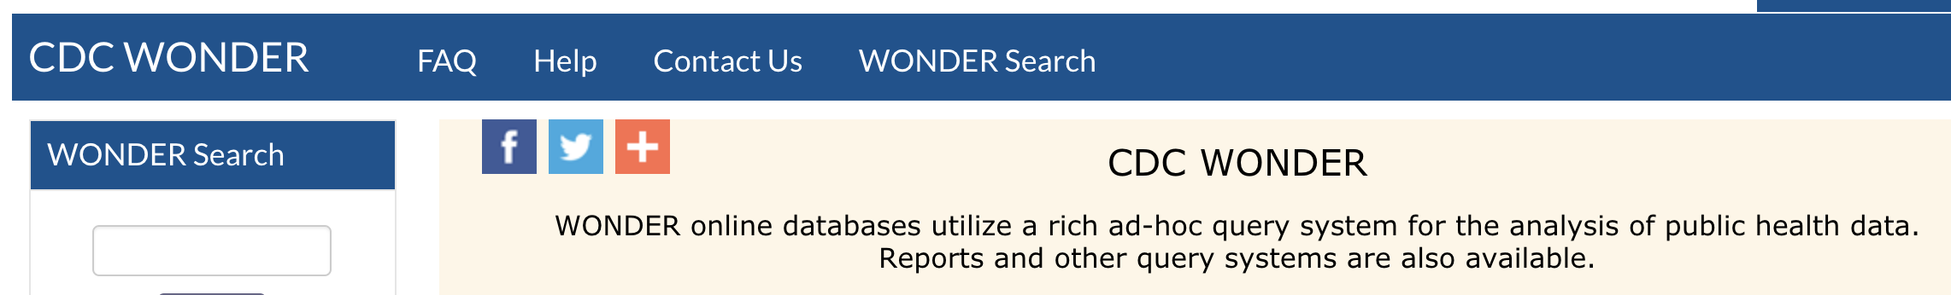
3.Dataset Description
Other dataset:
State Government Tax Collections (2016-2017)
Tax rate for each state
*
‹#›
Notes:
– Description of challenge and constraints
– Project objectives and performance metrics
– What you know and what you don’t

Slide 22
4. Class Imbalance
We tried both upsampling the minority class and downsampling the majority class.
‹#›

Slide 23

4. Hypothesis Introduction
Hypothesis 5: Increasing physical activity can alleviate the harmful effect of cigarette smoking.
A large percentage of the harmful effect of tobacco smoking is cardiovascular-related.
Cigarette smoking is one of the most preventable risk factor for cardiovascular disease.
Can regular exercise mitigate the harmful effects of smoking?
Initial Approach:
Exploratory Analysis
Feature Engineering
Correlation & Regression Analysis
‹#›

